Slide 1
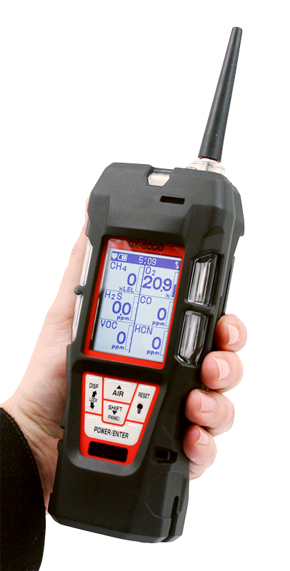
GX-6000
6 gas, sample draw with PID & Super Toxics

Slide 2
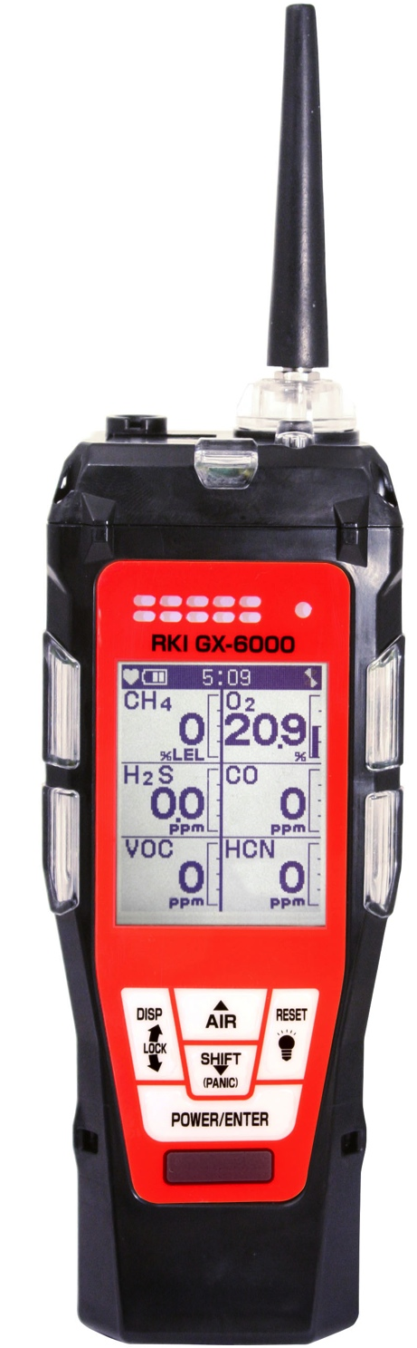
Features
Monitor up to 6 gases
4 standard micro-sensors
2 smart sensor slots for PID, IR, & Super Toxics
Library of over 600 VOC’s
Internal Sample Pump
New Features
  Man-down alarm
  LED flashlight
  Panic alarm
  180 degree auto display rotation

Slide 3
Features
New Features
Lightweight
High impact rubber boot
Ergonomic design fits comfortable in hand
IP 67 Protection Rating
Operating Hours
Rechargeable – 14 hours
Alkaline – 8 hours

Slide 4
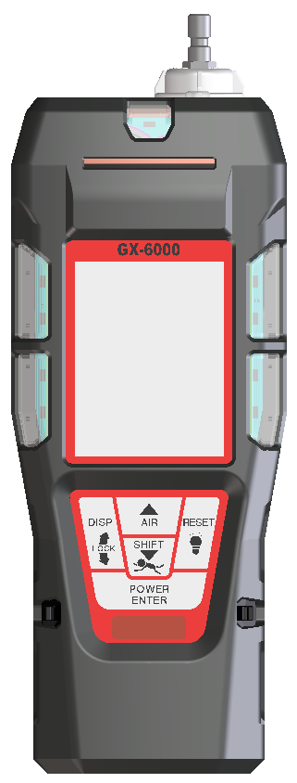
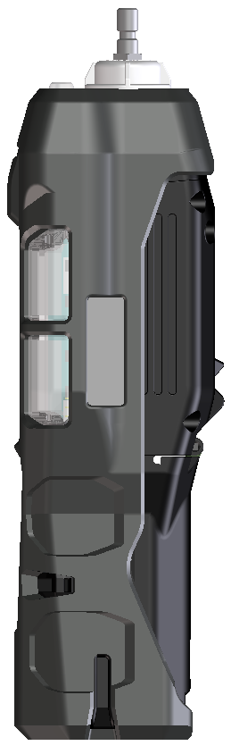
Compact & lightweight
Dimensions
7.87” (H) x 2.67” (W) x 2.04” (D)
GX-2012 = 6.81” x 2.79” x 1.69”
Weight
Approx. 400g / 14.1 ounce
GX-2012 : 360g / 12.7 ounce
7.87”
2.67”
2.04”

Slide 5
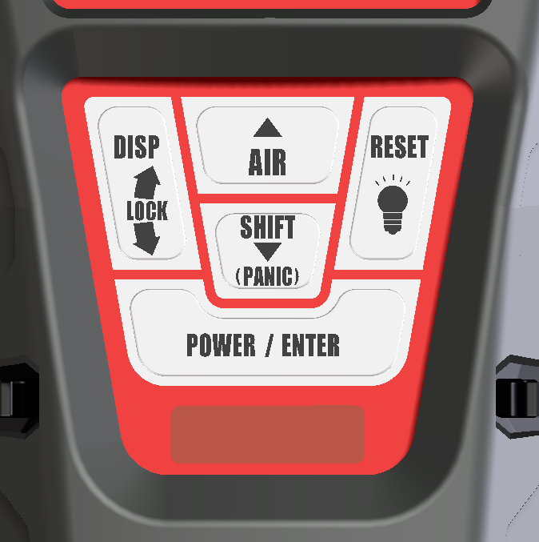
Control Panel
Glove friendly buttons can be operated with one hand
Functionality of each button is very similar to other RKI gas detectors (like GX-2012)
New functions are easily identifiable
  LED light
  Panic alarm
  Auto display rotation

Slide 6
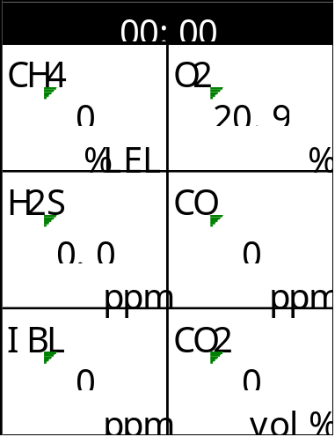
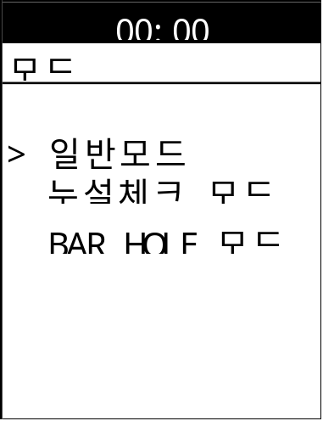
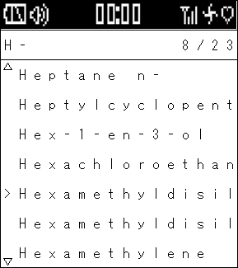
LCD Display
Display Examples
Full dot-matrix user-friendly LCD.
One of 9 languages can be selected by software.
  English, Germany, Italian, French, Portuguese, Spanish, Japanese, Korean, Russian

Slide 7
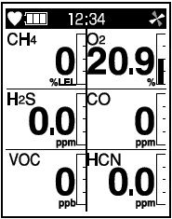
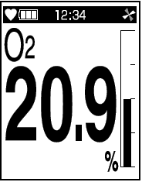
LCD Display Options
Multi-gas view displays all 6 channels
Single gas view shows one channel in large scale with auto scrolling for each channel
Auto rotation when instrument is turned upside down

Slide 8
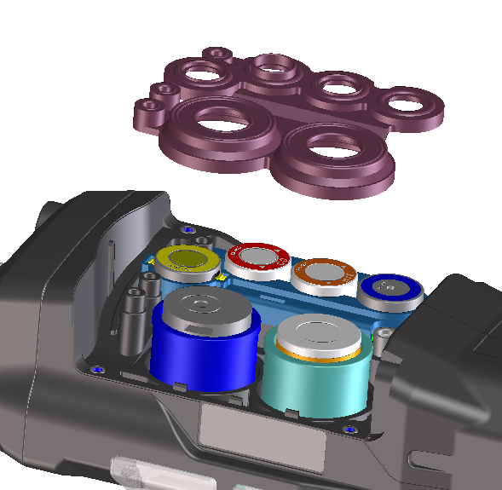
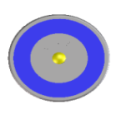
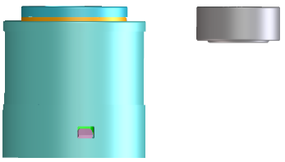
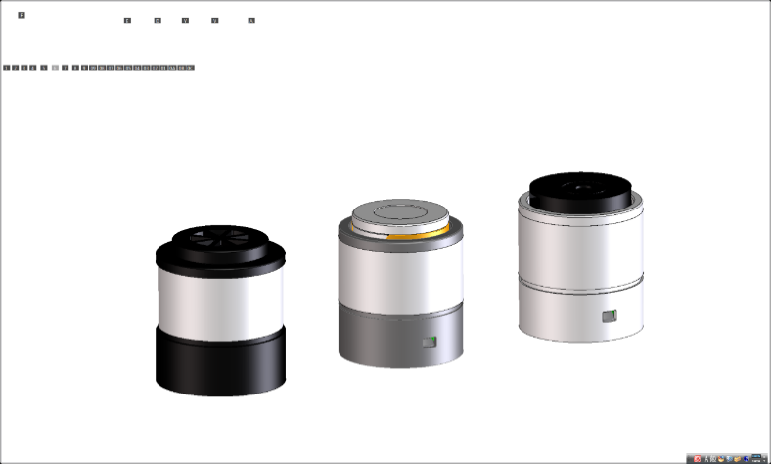
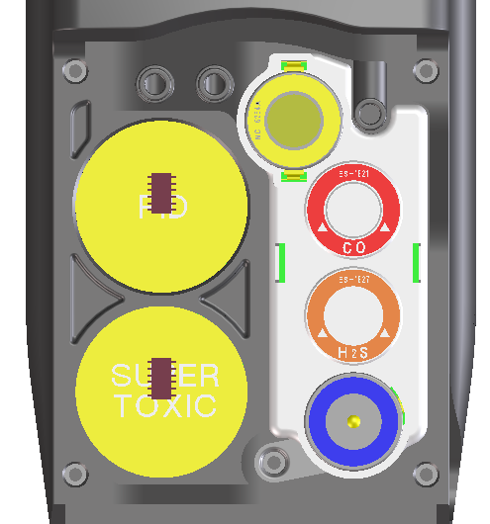
Sensors
Standard 4 gas sensors
CH4 or HC …..NC-6264A
O2 …..OS-BM2
H2S ..…ES-1827i
CO …..ES-1821
Smart sensors
PID …..PIS-00x (White)
ES …..ESS-03xx (Grey)
IR …..DES-3311-x (Black)
*Any two “smart” sensors can be combined in GX-6000, as long as PID sensor is located in the first position of the 2 smart sensor slots.
Note: Some sensors combinations have interferences. Check the manual for impractical sensor combinations on page 177.

Slide 9

Smart Sensor Gases
PID
Library of over 600 target gases
Iso-Butylene (C4H8) will be calibration gas standard.
EC
SO2 0-100 ppm
NO2 0-20 ppm
HCN 0-15 ppm
NH3 0-400 ppm*
Cl2 0-10 ppm*
IR
CO2 0-10% vol*
HC 0-100% LEL*
HC 0-30% vol*
CH4 0-100% LEL*
CH4 0-100% vol
CO2 0-10000 ppm

Slide 10
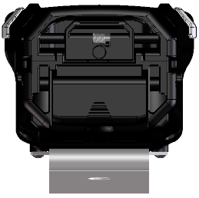
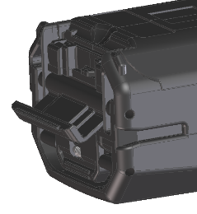
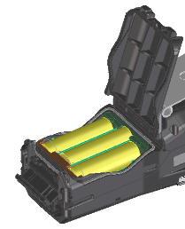
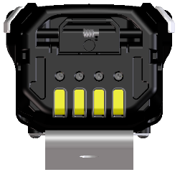
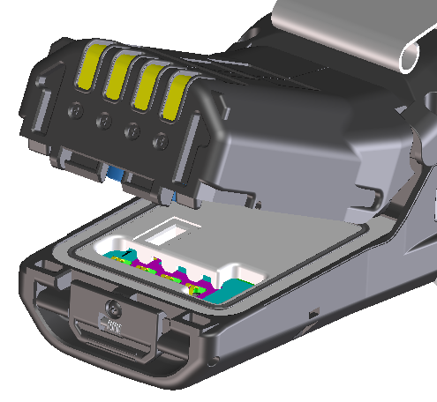
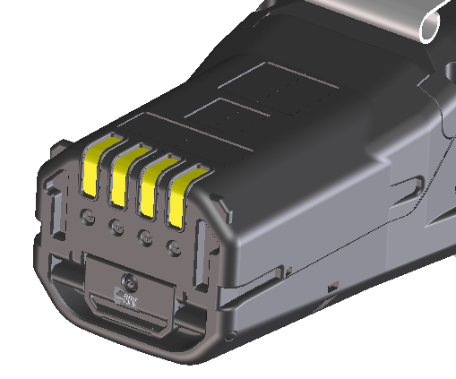
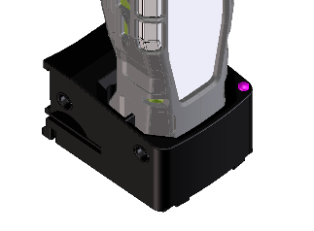
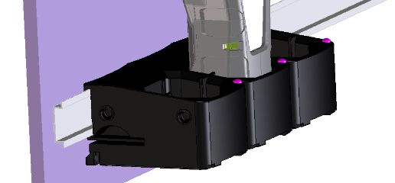
Power Supply
Alkaline
BUD-6000
AA size battery x 3 pieces
More than 8 hours operation
Rechargeable
BUL-6000
More than 14 hours operation
Battery charger BC-6000

Slide 11
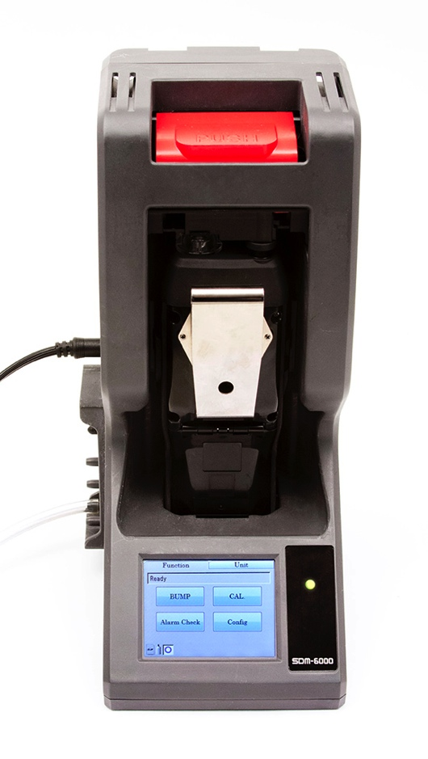
SDM-6000 Docking Station
Docking station can be connected to single PC (up to 10 units).
Available in December of 2015
Notes:
Can be connected up to 10 units

Slide 12
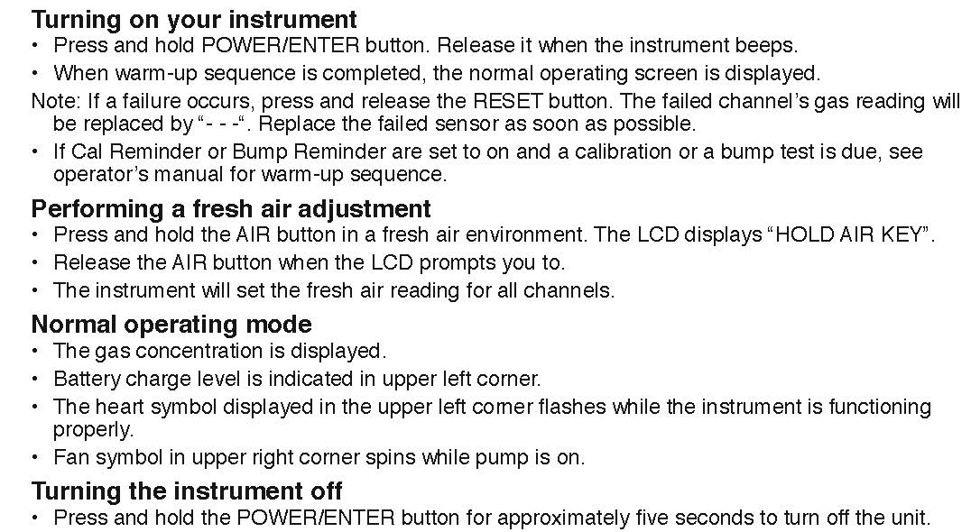
Quick Reference Card
Notes:
Can be connected up to 10 units

Slide 13
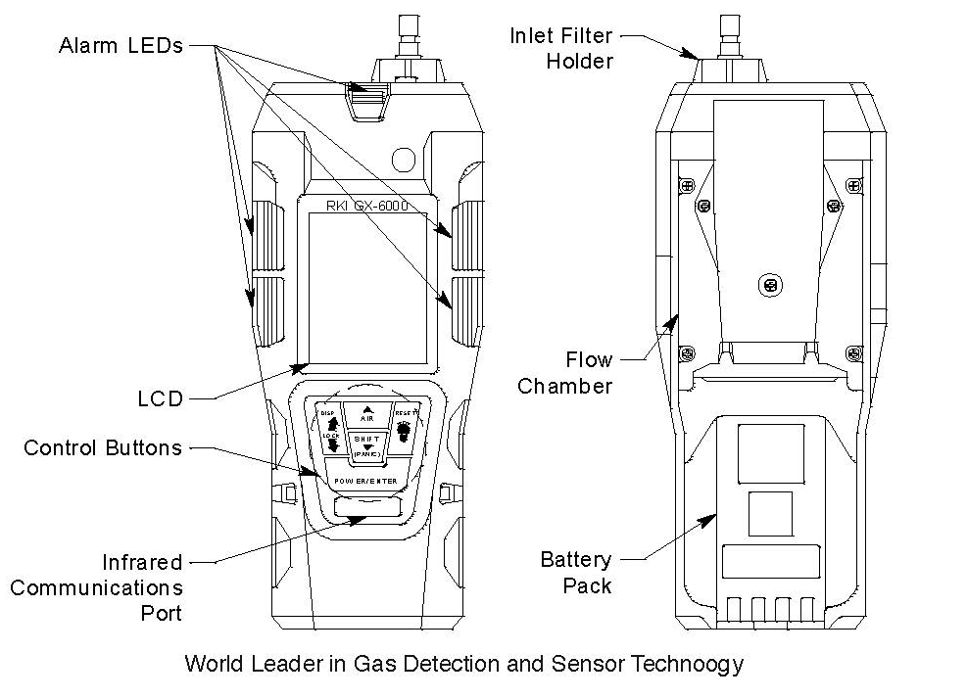
Quick Reference Card
Notes:
Can be connected up to 10 units

