Slide 1
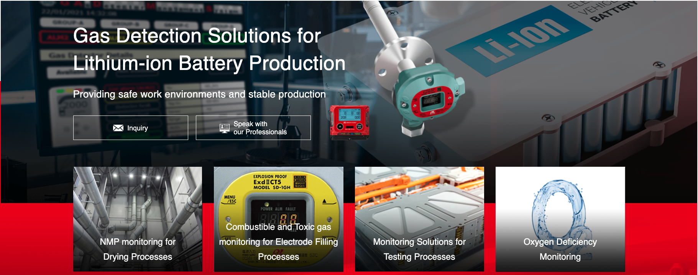
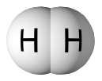
Lithium-ion Battery Market
Introduction
We have the Experience and the Solutions
Battery Storage
Monitoring

Slide 2







SUCCESSES

Slide 3
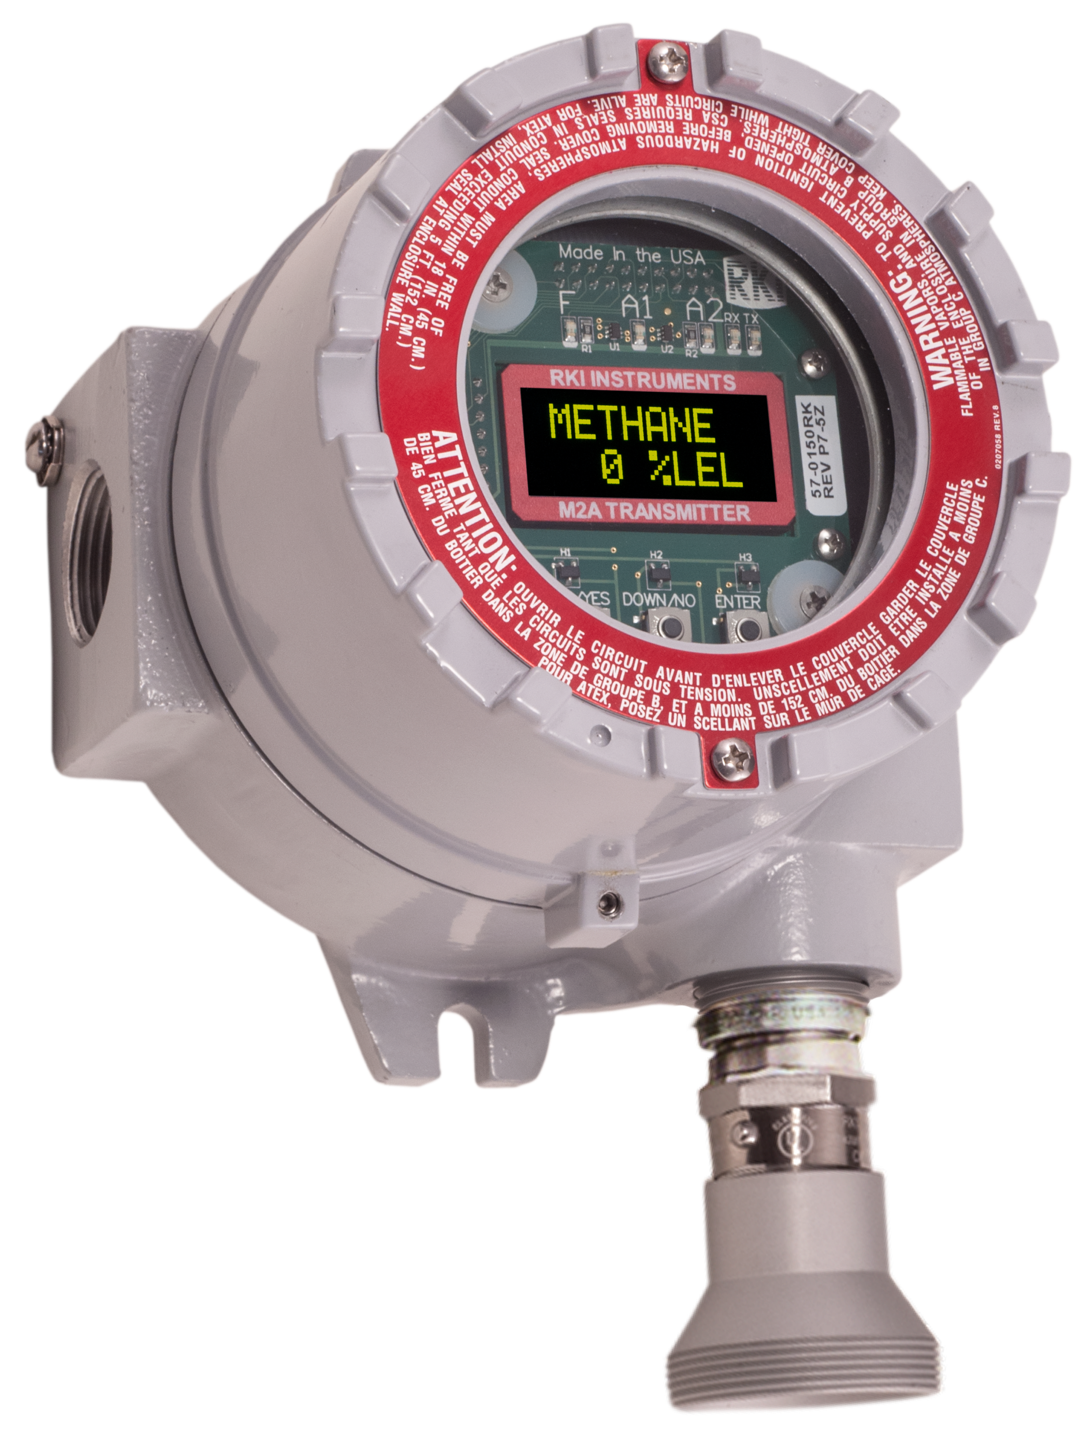
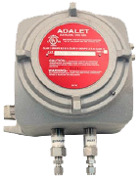
Tesla/Panasonic Gigafactory

Slide 4
Tesla/Panasonic Gigafactory
Equipment | Model | Gases | Ranges | Units
Liquid injection device | M2A（IR Type） | DMC | 0-100％LEL | 200
Liquid injection device | OX-5001-1017 | O2 | 0-25VOL% | 200
GNC Device | M2A（IR Type） | DMC | 0-100％LEL | 200
GNC Device | OX-5001-1017 | O2 | 0-25VOL% | 200
Encapsulation device | GP-6001-1017 | Xylene, Hexane | 0-100％LEL | 10
Coater machine | GP-5001-A2400 | NMP | 0-100％LEL | 126

Slide 5
Li-Ion Manufacturing Shipments
Company | Model | Gases | Units
Xalt Energy | SD-2500 | NMP | 50
LG Chemical | SD-2500 | NMP | 24
LG Chemical | S2 / M2A | Combustibles, O2 | 55
 | GD-A2400 | NMP | 26
Sweden | SD-1 Series | DEC, O2, Combustibles | 173
 | SD-2500 | NMP | 22
China | SD-1 Series | DEC, EMC, NMP | 1,000
 | SD-2500 | NMP | 3,644

Slide 6
Lithium Battery Production Process
Electrode manufacturing
Mixing
Coating
Drying
Calendering
Slitting
Vacuum drying
Gas detection
required
Cell assembly
Separation
Stacking Winding
Packaging
Electrolyte filling
Gas detector
required
Cell finishing
Degassing
HT aging
End of Line testing
Formation
Gas detector
required

Slide 7
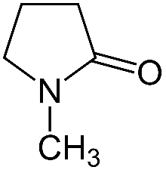
N-Methyl-2-pyrrolidinone(NMP) Physical properties
Chemical formula : C5H9NO
Molecular weight : 99.13
Lower explosion limit : 0.9 vol%
Flash point : 95 ℃
-> Exceeding this may produce air and
explosive gas mixtures
Boiling point : 204 ℃
Vapor pressure : 66 Pa(25 ℃) -> 7 %LEL
3200Pa(=3.2kPa)->350 %LEL(3.15 vol%)
Classification : Corresponds to third petroleum
Structure formula

Slide 8
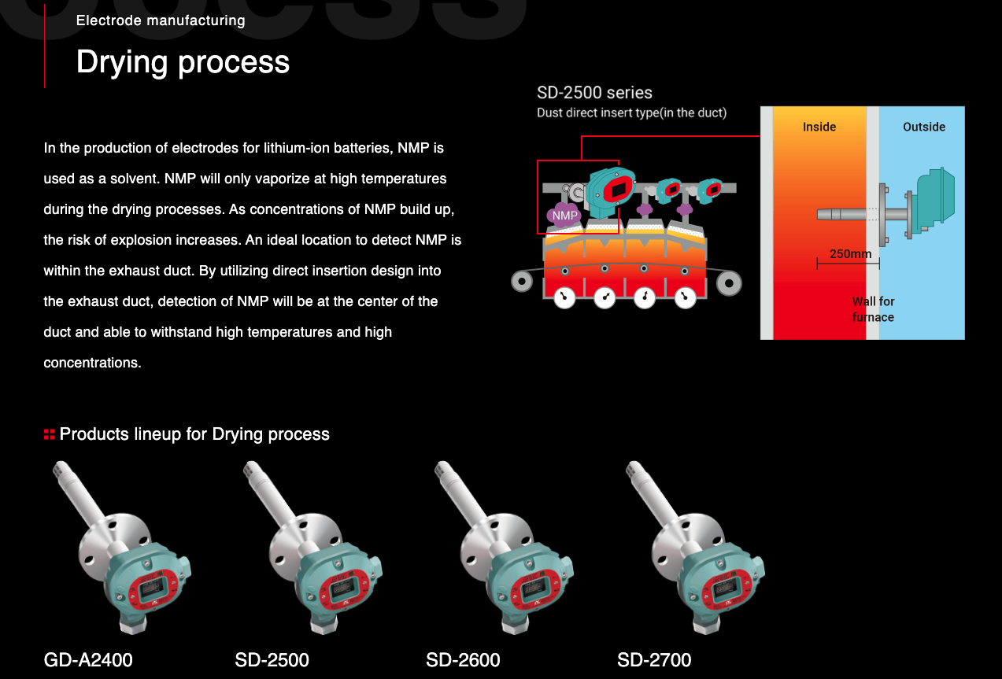
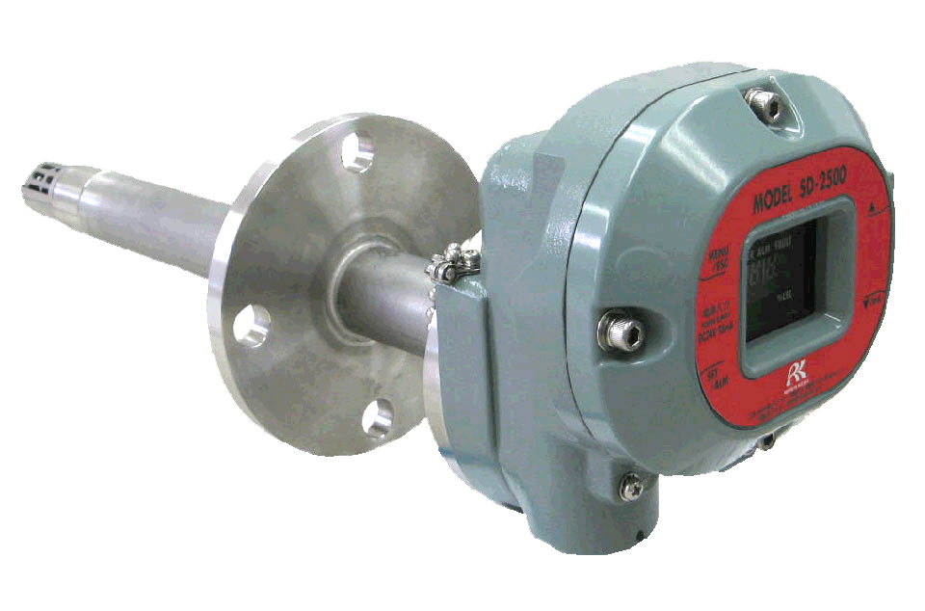
Duct direct insert type (sensor in duct)
SD-2500
SD-2500 Series

Slide 9
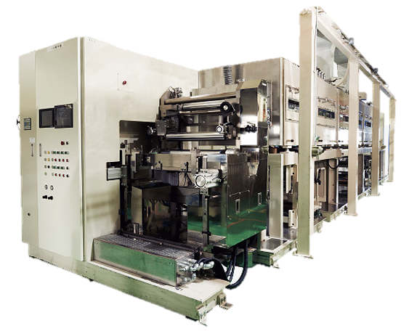
Coating & Drying Process
NMP is present all the time at the coating and drying process.
Purpose of gas detection
Confirm concentration is not decreasing
Confirm explosion limits are not exceeded
For 32GWh factory …
・around 8 lines
・around 18 sets of gas detectors per line

Slide 10
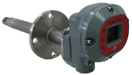
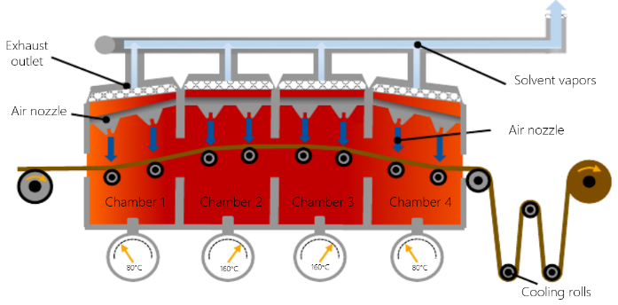
Coating and drying process mainly uses liquid NMP.
NMP off gasses can cause explosive environments in the drying process
SD-2500 series
Directly samples within the Duct
NMP
NMP
NMP
NMP
NMP volatilizes only at high temperatures.
Therefore, it is necessary to insert a detector directly into the exhaust duct and detect it at high temperatures.
Notes:
NMP liquifies at low temperatures.

Slide 11
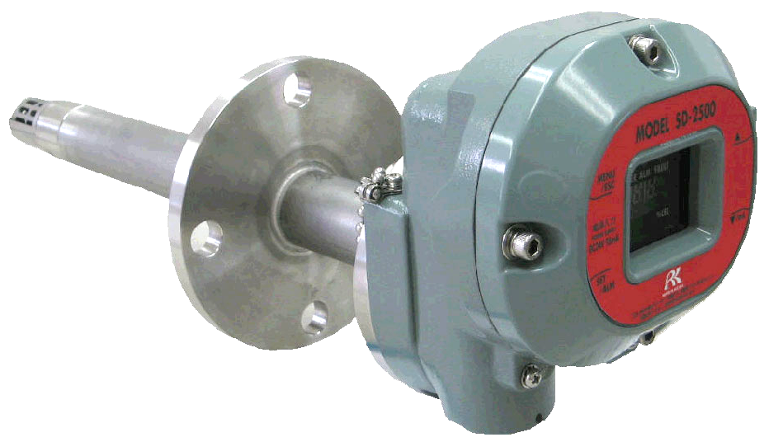
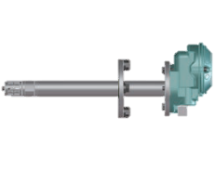
Product advantage
Directly detecting inside the DUCT
Accurate detection is possible because there is no risk of condensation (liquefaction)
1. No risk of liquefaction
avoid solvent adsorption on piping and sensors.
2. Duct insert diffusion method
Real time response.
3. No sample pump required
low operational cost
Model: SD-2500
Layout drawing

Slide 12
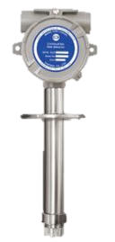
Major Competitive Advantages
RIKEN KEIKI
- SD-2500 : 0- +320° F
- SD-2600 : 0- +392° F
GASTRON
GTD-2000: -4°F - +140° F
UL/ATEX approval
ATEX approval
Riken Keiki Advantages
1) UL/ATEX certifications
2) Widest temperature range
3) Local display of gas readings

Slide 13
Lithium Battery Production Process
Electrode manufacturing
Mixing
Coating
Drying
Calendering
Slitting
Vacuum drying
Gas detection
required
Cell assembly
Separation
Stacking Winding
Packaging
Electrolyte filling
Gas detector
required
Cell finishing
Degassing
HT aging
End of Line testing
Formation
Gas detector
required

Slide 14
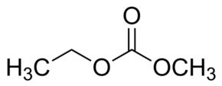

Ethyl methyl carbonate(EMC) Physical properties
Chemical formula : C4H8O3
Molecular weight : 104.10
Flash point : 23.9 ℃
-> Exceeding this may produce air and
explosive gas mixtures
Boiling point : 101 ℃
Vapor pressure : 43 hPa(25 ℃)
Structure formula

Slide 15
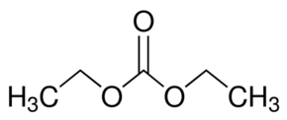
Diethyl carbonate(DEC) Physical properties
Chemical formula : C5H10O3
Molecular weight : 118.13
Flash point : 25 ℃
-> Exceeding this may produce air and
explosive gas mixtures
Boiling point : 126-128 ℃
Vapor pressure : 13 hPa(23.8 ℃)
Structure formula

Slide 16
Dimethyl carbonate(DMC) Physical properties
Chemical formula : C3H6O3
Molecular weight : 90.08
Lower explosion limit : 4.2 vol%
Flash point : 18 ℃
-> Exceeding this may produce air and
explosive gas mixtures
Boiling point : 90.2 ℃
Vapor pressure : 7.4 kPa(25 ℃) -> 173 %LEL(7.3 vol%)
Classification : Corresponds to first petroleum
Structure formula

Slide 17
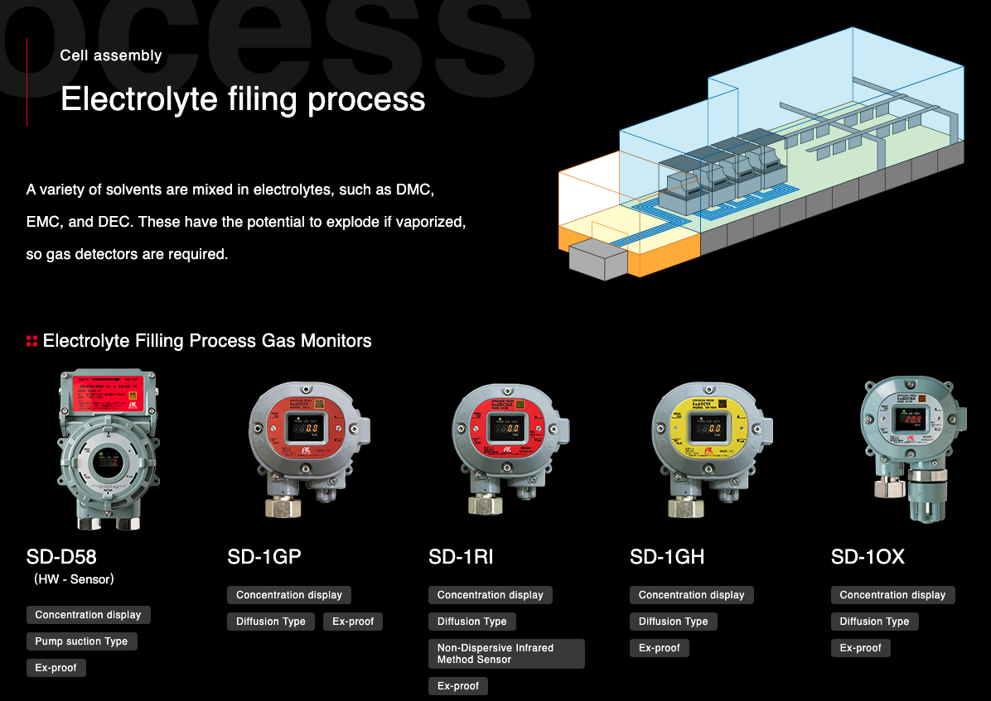
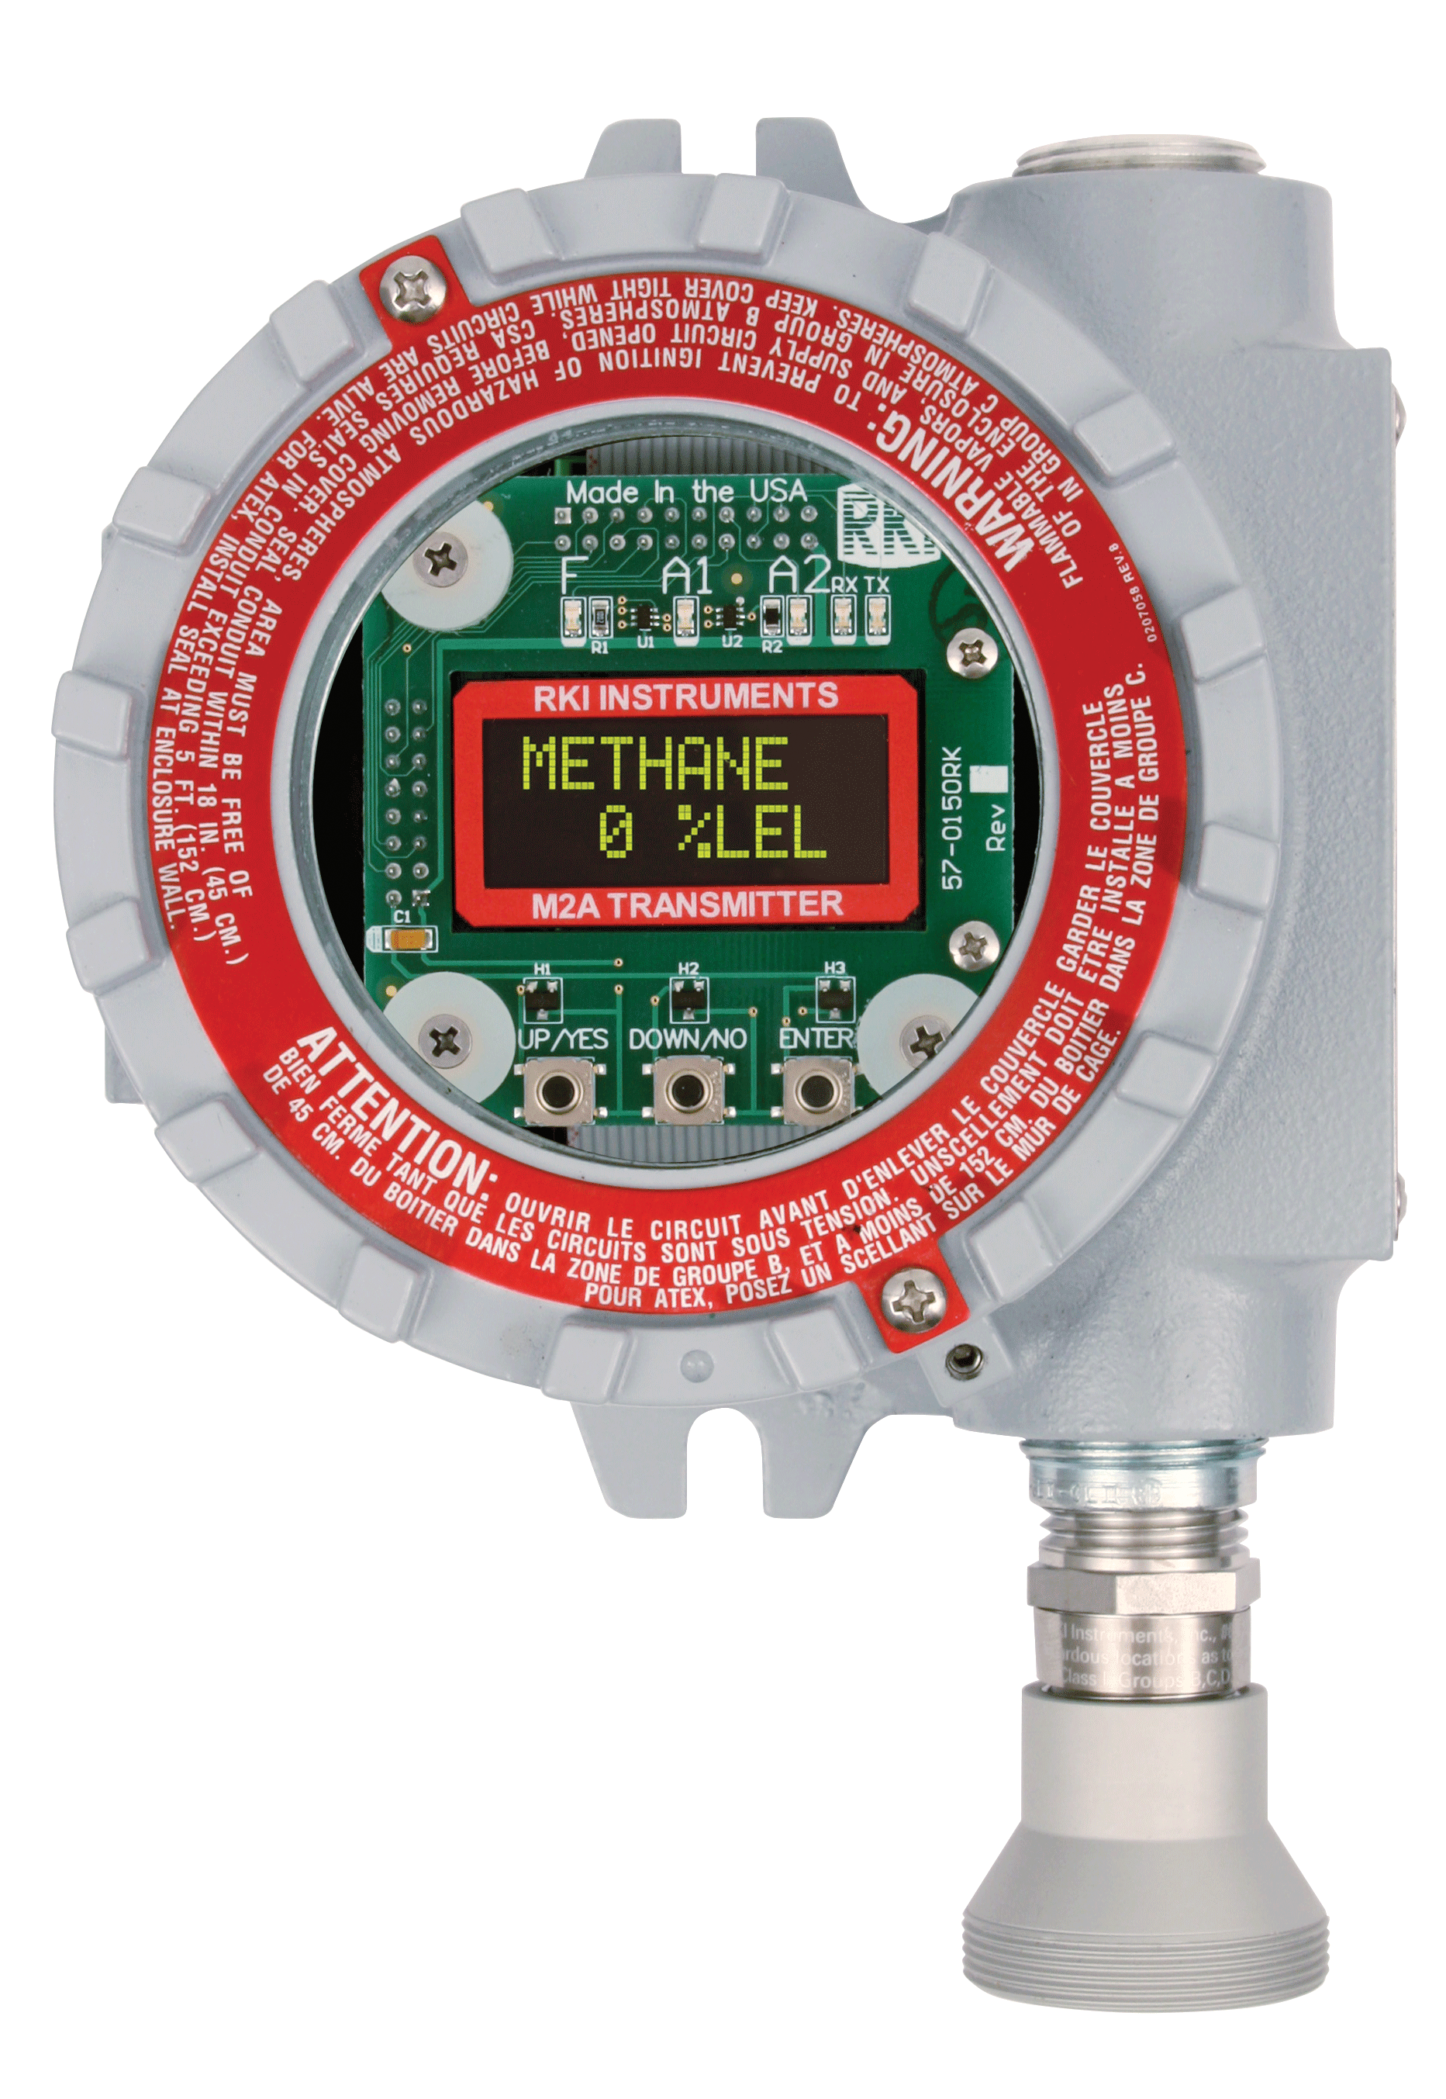
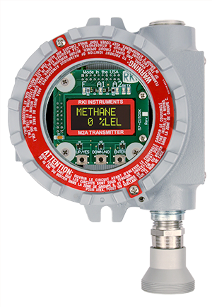
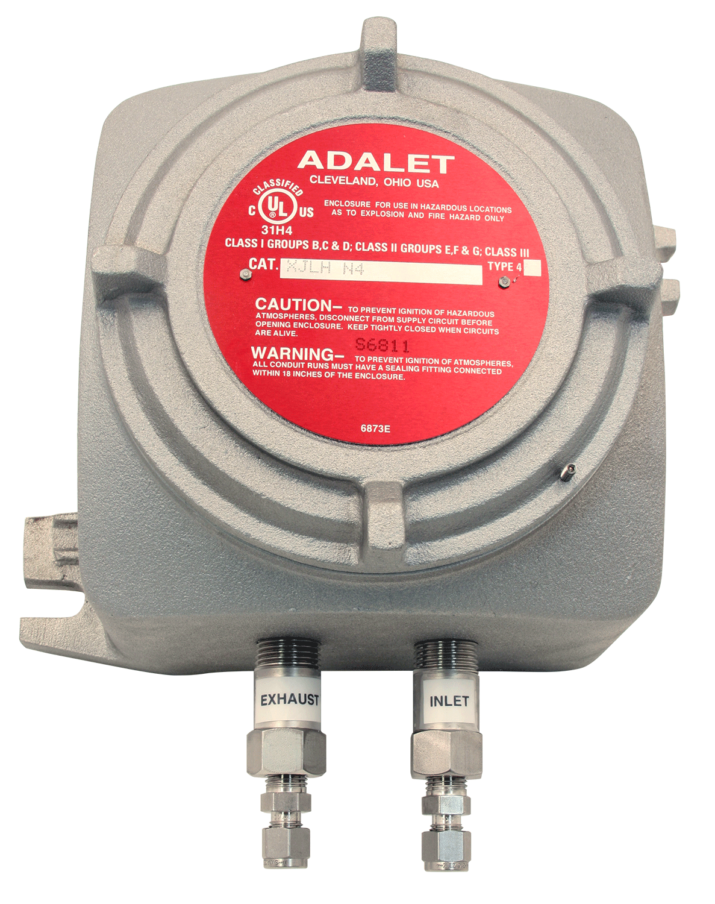
1017
M2A
M2A
CSA approval
Sample draw
IR HC or O2

Slide 18
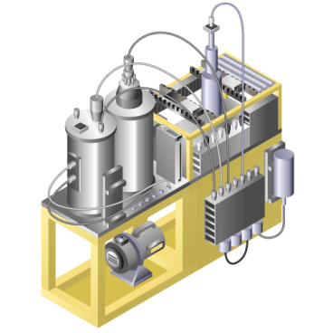
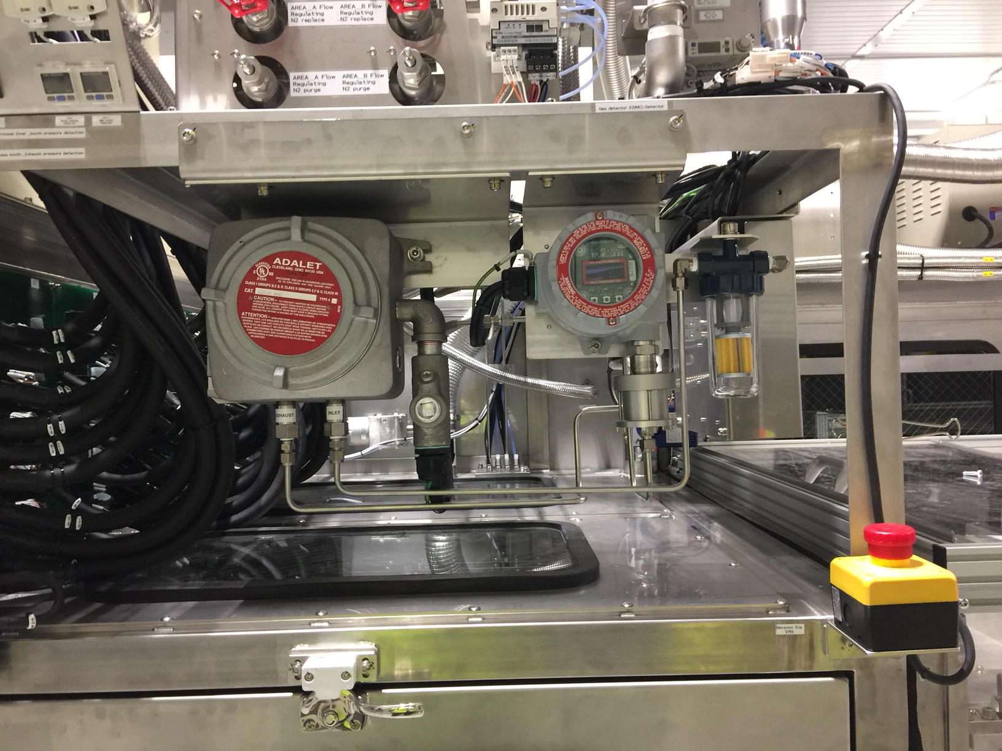
The electrolyte contains DMC (dimethyl carbonate) and when it is vaporized, it becomes an explosive atmosphere.
M2A – DMC
Model 1017
For a 32GWh factory …
・around 24 lines
・around 20 sets of gas detector per line

Slide 19
Lithium Battery Production Process
Electrode manufacturing
Mixing
Coating
Drying
Calendering
Slitting
Vacuum drying
Gas detection
required
Cell assembly
Separation
Stacking Winding
Packaging
Electrolyte filling
Gas detector
required
Cell finishing
Degassing
HT aging
End of Line testing
Formation
Gas detector
required

Slide 20
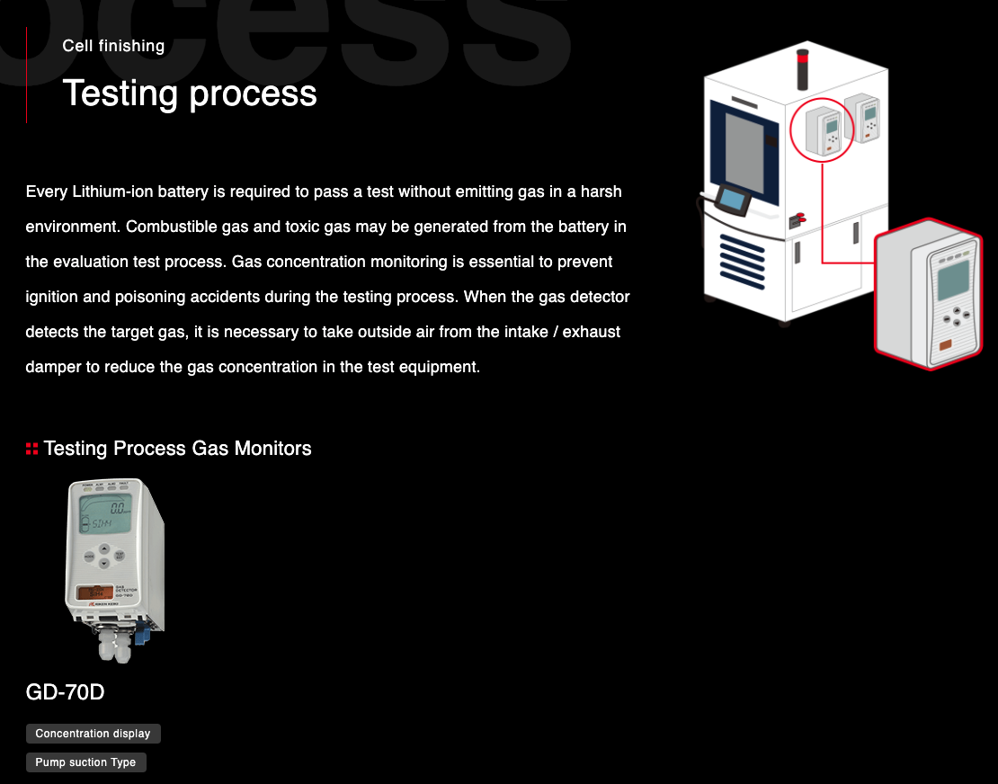
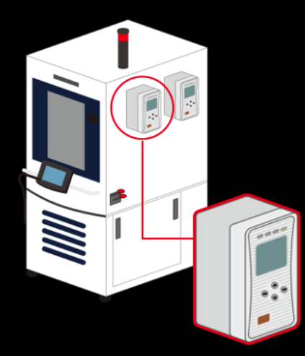
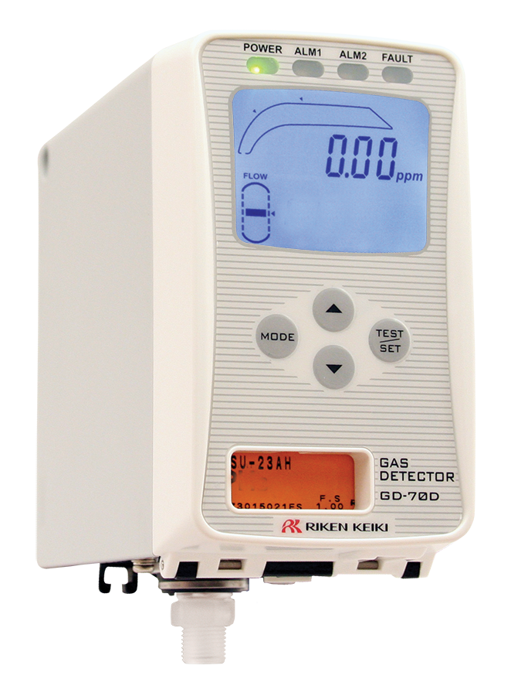
Every Lithium-ion battery is required to pass a test without emitting gas in a harsh environment. Combustible gas and toxic gas may be generated from the battery in the evaluation test process. Gas concentration monitoring is essential to prevent ignition and poisoning accidents during the testing process. When the gas detector detects the target gas, it is necessary to take outside air from the intake / exhaust damper to reduce the gas concentration in the test equipment.
GD-70D
Sample Draw with display

Slide 21
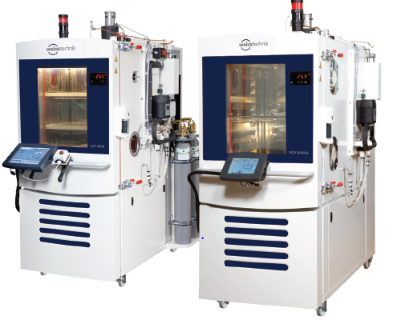
Cell Finishing – EOL Test process
Depending on the type of battery H2, CO, H2S, HF can off gas
Use：Explosion prevention/toxic gas
exposure (H2/CO/H2S/HF)
Model：GD-70D
Typically 1 or 2 gas monitors per test equipment.
Test equipment
Notes:
Since the environment inside the test equipment is extremely harsh, it is necessary to perform pretreatment by sampling (air-cooled dehumidification, activated carbon adsorption, etc.).

Slide 22
Battery Storage

Slide 23


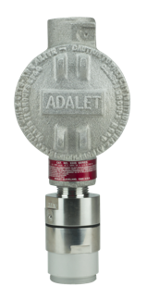

Common Fixed System Components
Beacon 410A Controller
S2 Transmitter
M2A Transmitter
Direct Connect Sensor
RKI’s diffusion style remote mount detectors allow for easy calibrations in difficult access areas
Alarm Relays Activate Ventilation / Exhaust System

Slide 24

H2 Low PPM Sensors & Transmitters
0 – 100 PPM H2 range
Metal Oxide Sensor (MOS) sensor technology
Early stage detection of H2 off gas
Available in the S2 transmitter
Ideal for Lithium Ion battery storage
S2 Transmitter

Slide 25
Product Information

Slide 26
Coating & Drying Processes
Flame-proof Furnace Safety Monitor
Model：SD-2500
Features
Detection of high boiling point solvents
Local digital display
1 built in alarm relay

Slide 27
Electrolyte Filling Process
Stand Alone Explosion Proof Transmitter
Model：M2A
Features
Suitable for use as an explosion proof product even in hydrogen atmospheres
Operates with or without a controller
Direct digital readout with OLED display
2 alarm relays plus fault relay
Non-intrusive calibration via magnetic wand
Long-life sensors (3 to 5 years typical)

Slide 28
Electrolyte Filling Process
Explosion Proof Sample Draw Pump
Model: 1017
Features
Suitable for use as an explosion proof product with or without sensor
Sampling range up to 100’
Cast aluminum alloy housing
Stainless steel inlet and outlet fittings with flame arrestors
Operates on 24VDC input
UL certified

Slide 29
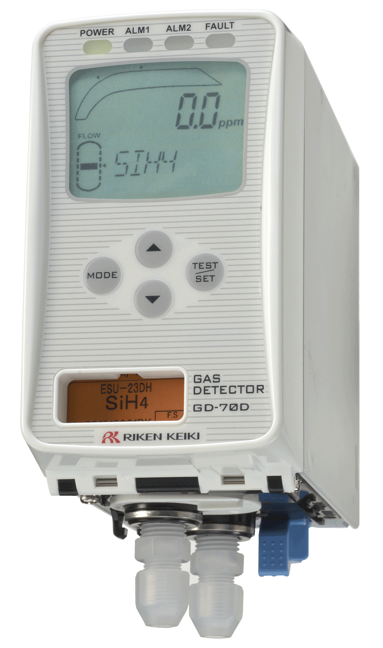
Testing Process
Smart Transmitter / Gas Detector
Model：GD-70D
Features
A universal design with interchangeable smart sensor technology. The main unit is shared.
Front access, no tools required for easy replacement of sensor & pump
Plug and play smart sensors retain calibration and sensor data
2 alarm relays plus fault relay
UL61010-1:2012 R7.19 certified by TUV

Slide 30
Personal Portable Solutions

Slide 31
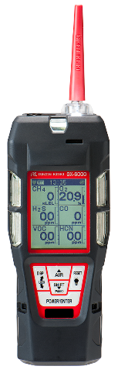
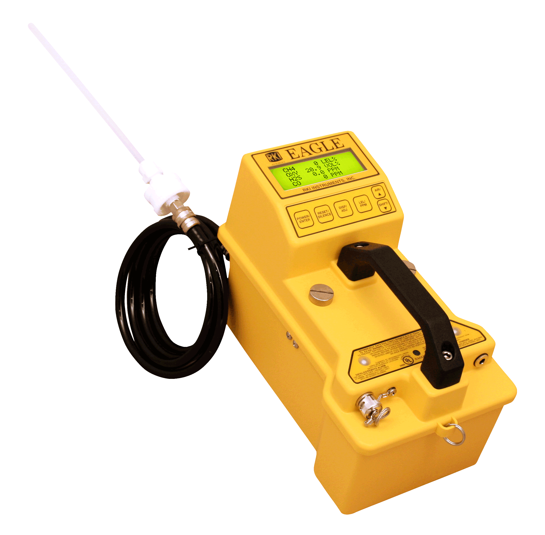

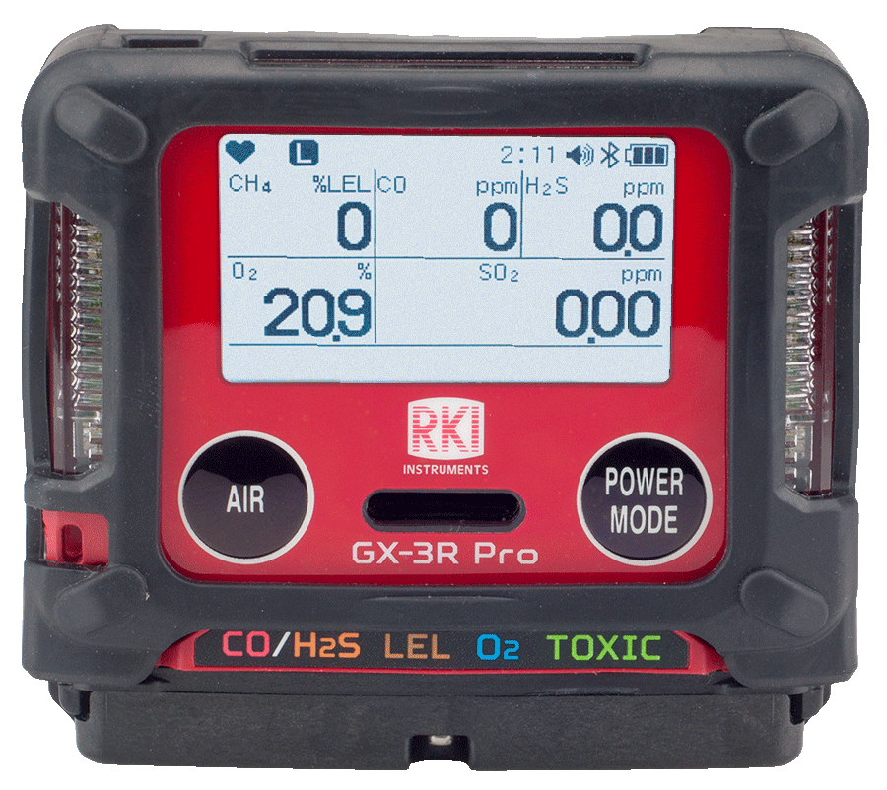

Personal Safety | Confined Space | VOC Detection
Portable Gas Monitors
Model：GX-3R | GX-3R Pro | GX-6000 | EAGLE
GX-3R
Smallest confined space monitor
25 hours of operation
3-year warranty
GX-3R Pro
Smallest 5 gas monitor
Bluetooth alarm notifications
Panic Alarm
Man-down Alarm
Toxics/IR Sensors: HCN, NH3, NO2, PH3, SO2, and CO2
GX-6000
6 gas sample draw with smart sensors
4 PID sensor options
5 operating modes
EAGLE
6 gas sample draw
Over 400 configurations including LEL / O2 / HF
PPM/LEL combustible detection ranges
Breathing Zone Monitor

