Slide 1
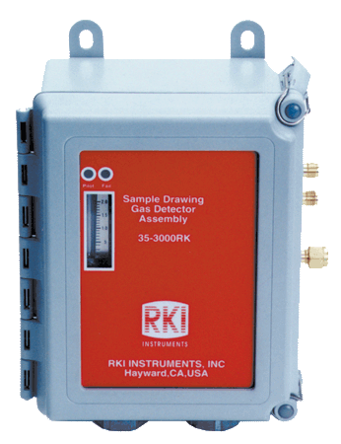
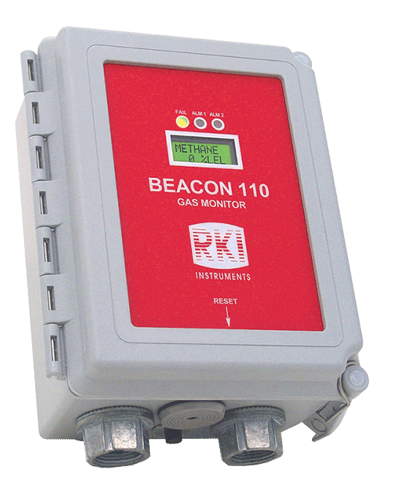
RKI Permanent Monitors

Slide 2
35-3000 Series
Sample Draw Detector

Slide 3
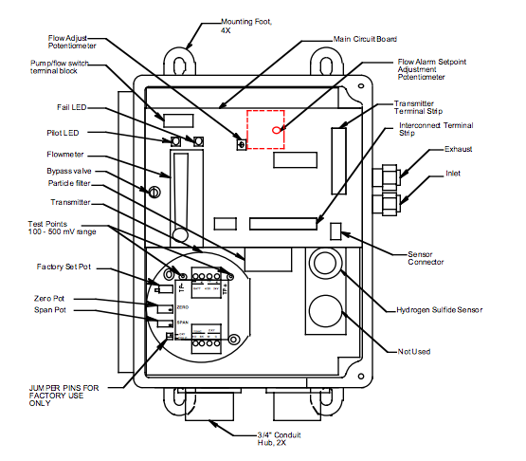
Components
This drawing applies to H2S and CO models.

Slide 4
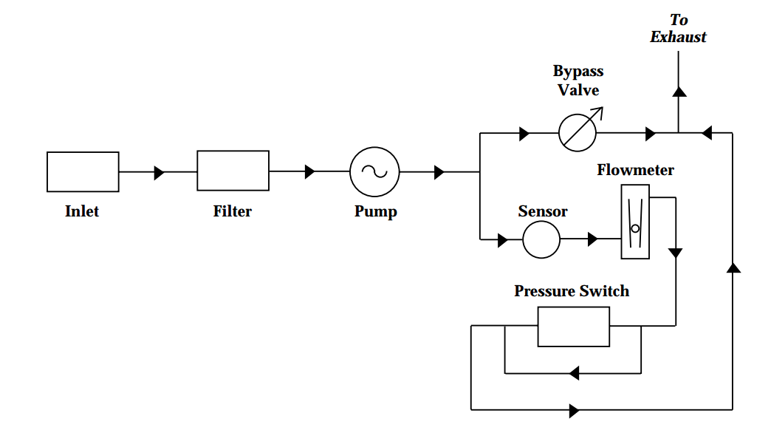
Flow System
The sample-draw detector’s flow system consists of the INLET fitting, filter, pump, flowmeter, bypass valve, status lights, pressure switch, and EXHAUST fitting.

Slide 5
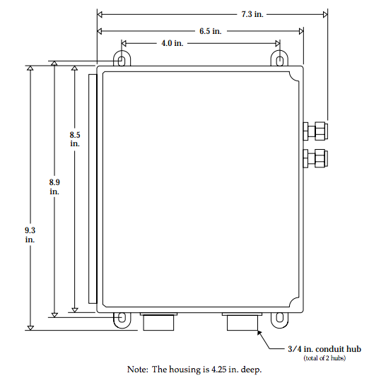
Mounting Dimensions

Slide 6
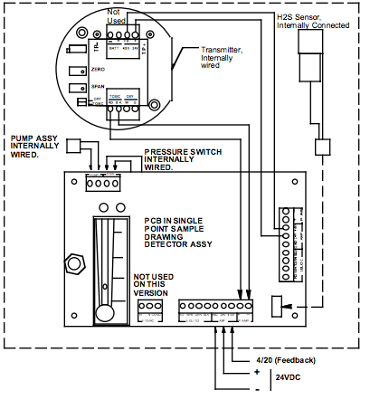
Wiring
This drawing applies to H2S and CO models.

Slide 7
Beacon 110 Controller

Slide 8
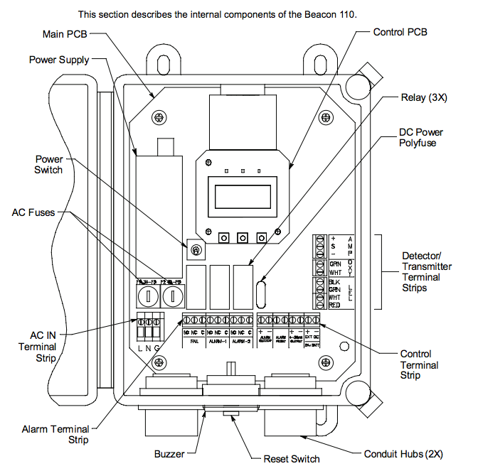
Components

Slide 9
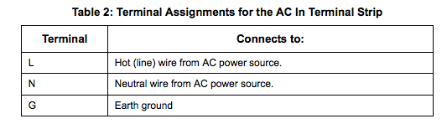
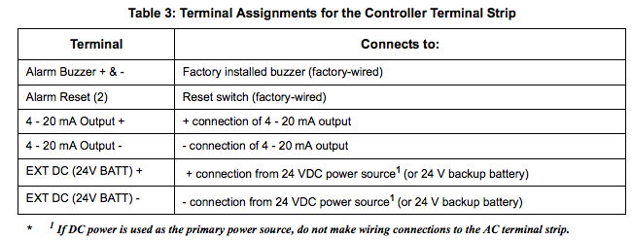
Wiring

Slide 10
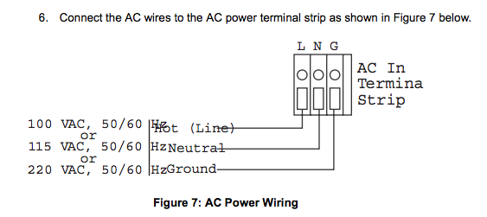
Power Wiring

Slide 11
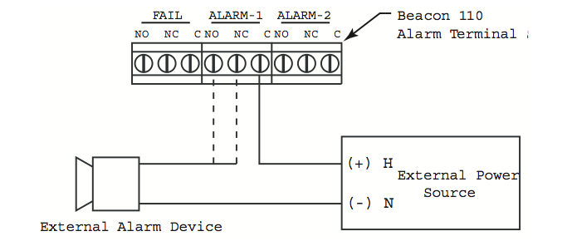
WIRING

Slide 12
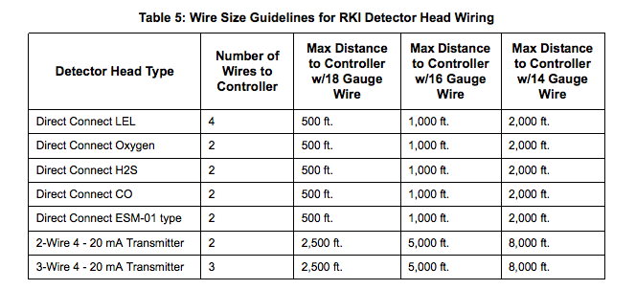
Wire Sizes

Slide 13
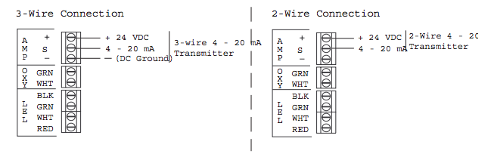
4-20 mA Transmitter Wiring

Slide 14
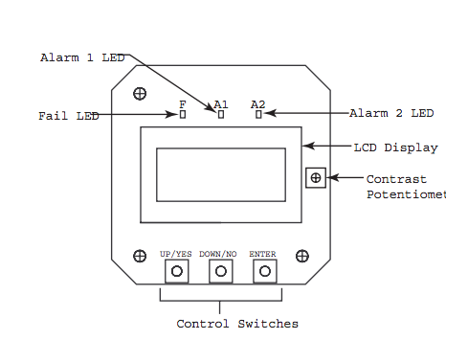
Control PCB Components

Slide 15
Preparing for Calibration
NOTE: Calibrating the sample draw adapter may cause alarms. Be sure to put the
controller into calibration mode or disable external alarms before calibrating.
Open the housing door.
Set a voltmeter to measure in the millivolt (mV) range.
Plug the positive lead into the transmitter test point labeled TP+; plug the negative lead into the transmitter test point labeled TP-.
Use the following formula to determine the correct test points output for the calibrating sample.
  Output (mV) = (calibrating sample/full scale) X 400 + 100
  For example, with a calibrating sample of 50 ppm CO and a full scale setting of 300 ppm, the correct output is 167 mV.
  167 DC (mV) = (50/300) X 400 +100

Slide 16
Assembling Calibration Kit
Connect the calibration kit sample tubing along with the tubing clamp to the fitting on the gas collection bag.
Connect the sample tubing from the gas collection bag to the inlet line at or near the INLET fitting. Allow the sample draw pump to draw out any residual gas in the gas collection bag. NOTE: This will cause a low flow alarm when the bag is empty. Normal operation of the sample draw adapter will resume when the tubing is disconnected from the inlet line.
Disconnect the calibration kit sample tubing from the inlet line.
Close the clamp right away. The clamp is attached to the calibration kit sample tubing. NOTE: If you can verify a fresh air environment, it is not necessary to use a zero air calibration cylinder to set the zero reading. Go to the next section, “Setting the Zero Reading.”
Connect the tubing from the gas collection bag to the fixed flow regulator, then open the clamp.
Screw the fixed flow regulator onto the zero air calibration cylinder. The gas collection bag begins to fill.
When the bag is full, unscrew the fixed flow regulator from the cylinder.
Close the clamp, then disconnect the sample tubing from the fixed flow regulator.

Slide 17
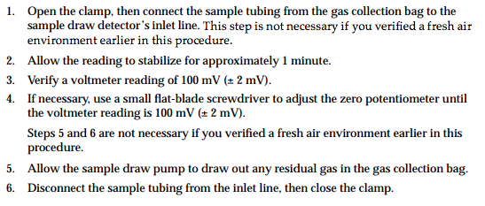
Setting the Zero Reading

Slide 18
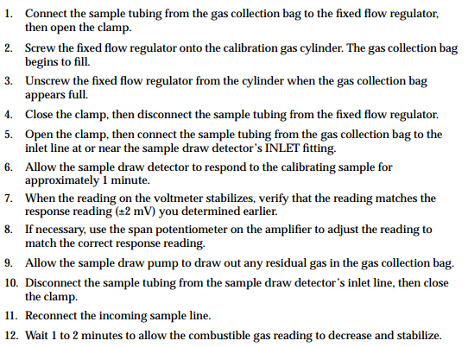
Setting Response Reading

